Slide 1
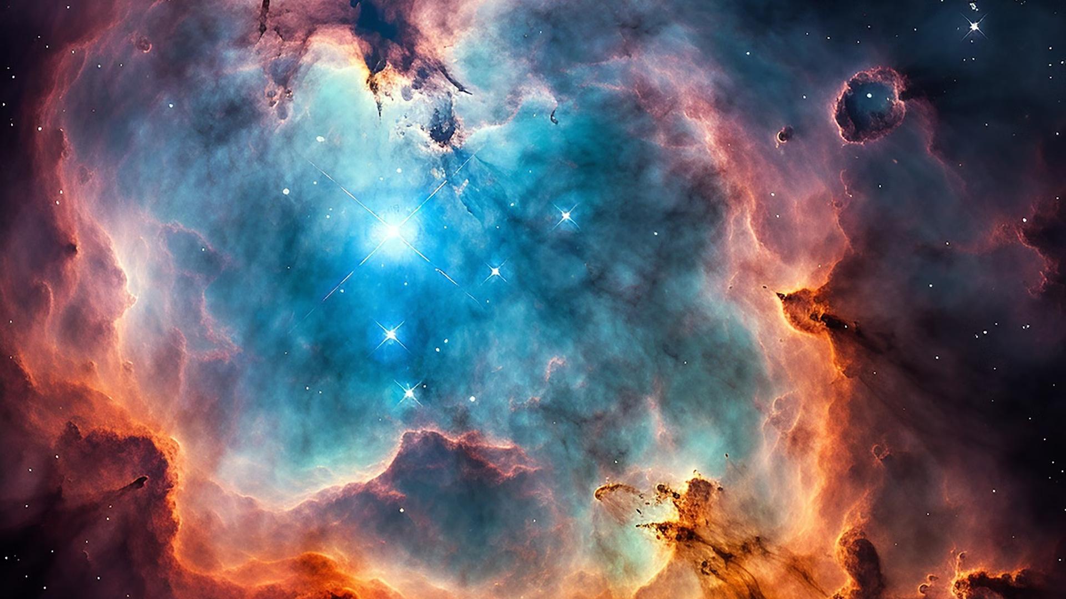
Cosmos Pioneers
Our team is made up of talented individuals with expertise and passion.
Team Members:
Punit Bhatarkar
Aditya Patil
Ritesh Patil
Atharva Kamble
Nikhil Shinde
Soham Chaudhary
Challenge : Create an Orrery Web App that Display Near Earth Object

Slide 2
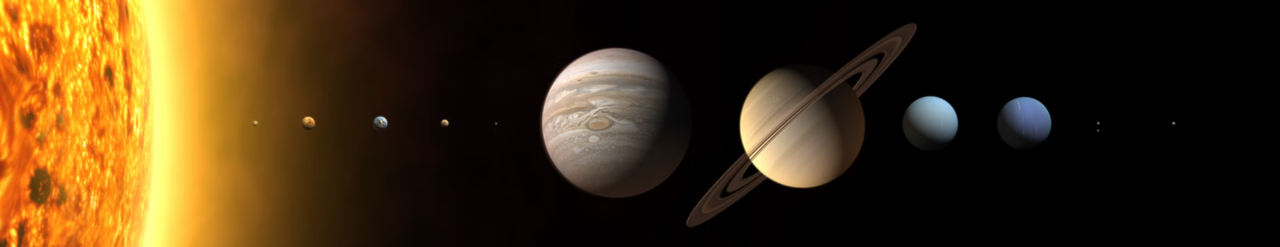

Understanding Orrery
1
What is Orrery
2
Educational Tools
3
Scaled Representations
Orrery is a clockwork model of the solar system, or of just the sun, earth, and moon.
Orrery help people learn about the solar system.
Orrery make the distances and sizes of space objects easier to understand.

Slide 3
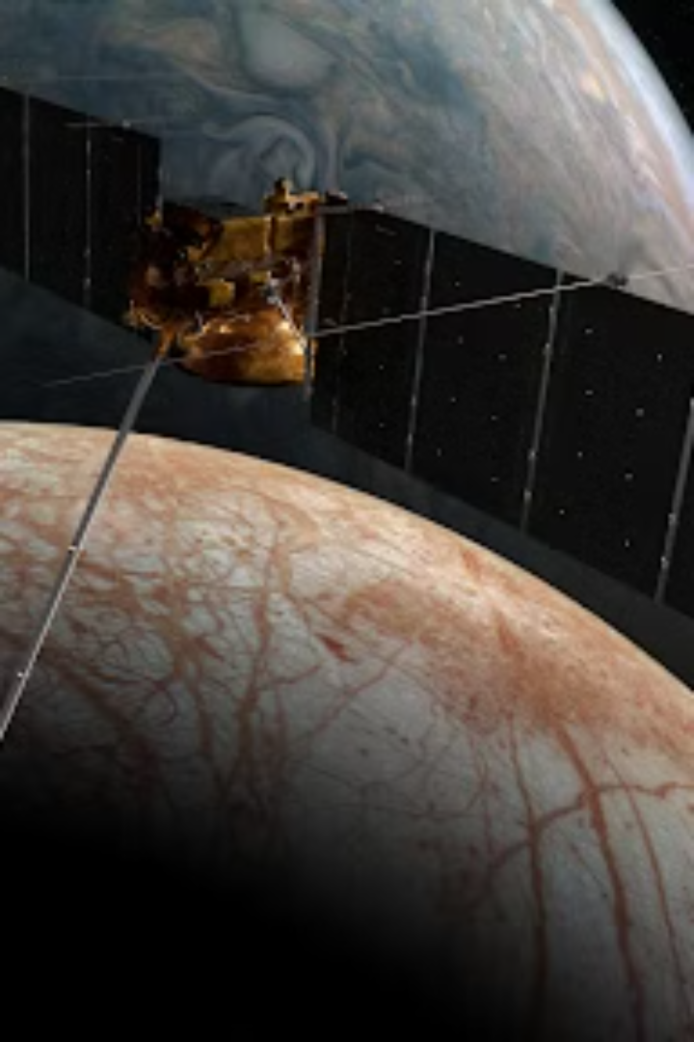
NASA's NEO Program
Tracking NEOs
Impact Assessment
Educational Resources
Provides detailed data on near-Earth object orbits.
Evaluates potential threats posed by certain NEOs.
Offers news updates and learning materials.
Notes:
NASA's Near-Earth Object (NEO) program is responsible for tracking, assessing, and educating the public about potentially hazardous asteroids and comets. The program provides detailed data on the orbits of NEOs, allowing scientists to better understand their trajectories and potential impact risks. The impact assessment component of the program evaluates the threats posed by certain NEOs, helping to determine which ones require further monitoring or potential mitigation efforts. In addition to the technical work, the NEO program also offers educational resources, such as news updates and learning materials, to inform the public about these celestial objects and the efforts to study them. The goal is to continuously improve our understanding and monitoring of NEOs in order to protect our planet from potential impacts.

Slide 4
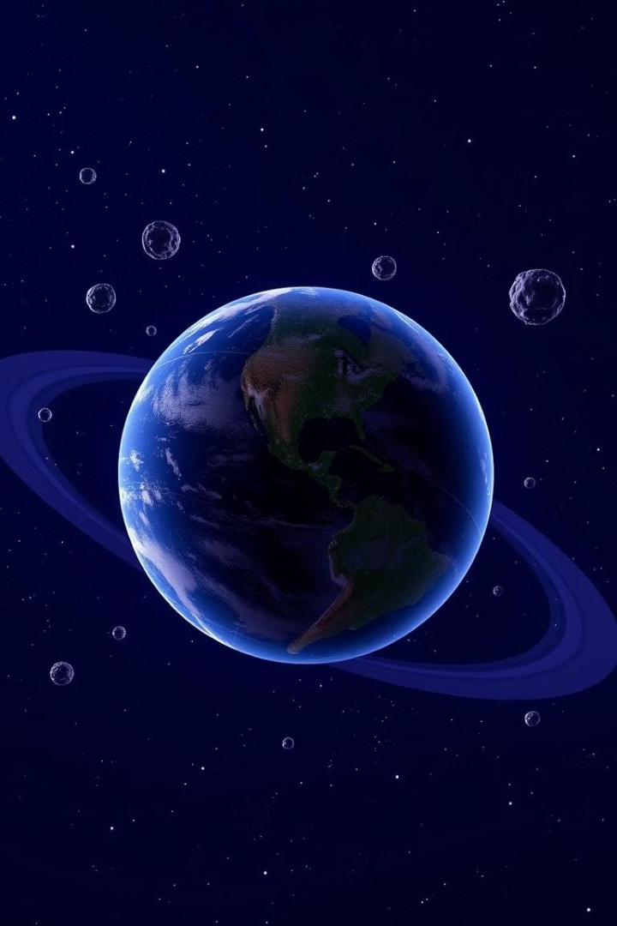
Asteroid Watch
1
Visual Representation
Displays near-Earth objects.
2
Interactive Orrery Display
Provides an interactive tool for exploring NEO orbits and their characteristics.
3
Educational Simulation
Offers engaging simulations and information about recent asteroid discoveries.

Slide 5
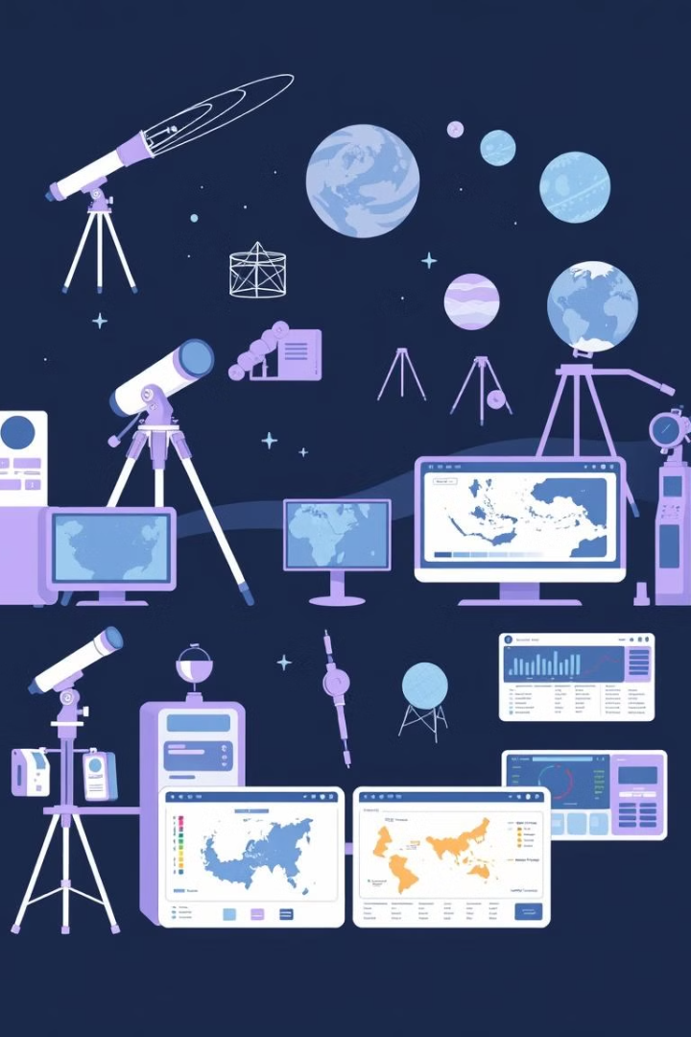
Key pioneering neo Website Features
Orbital Data
Research and Exploration
Provides detailed information on NEO orbits.
Enables in-depth research on NEOs and facilitates exploration.
Visualizations
User-Friendly Design
Features interactive models and graphics representing NEO trajectories.
Provides customizable views of NEO data.

Slide 6
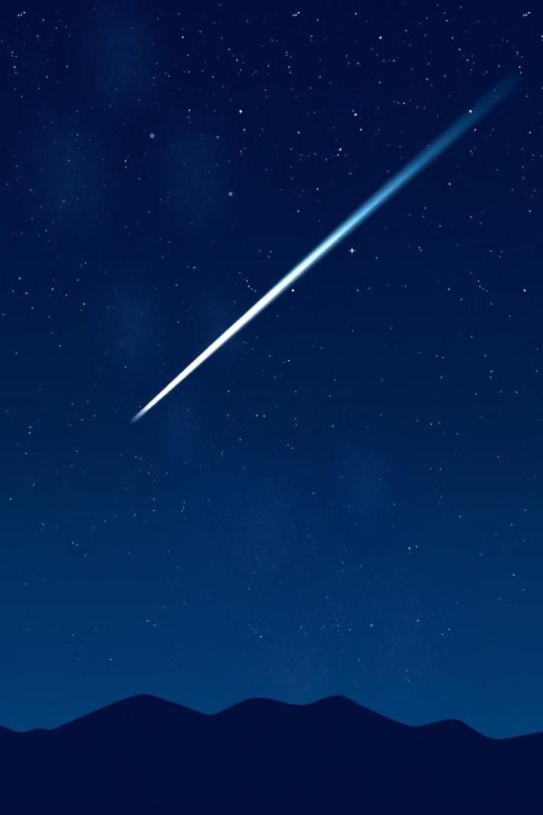




Innovating Beyond Earth
Observation
Analysis
Monitoring near-Earth objects.
Evaluating potential of humans analyzing solar system
Outreach
Exploration
Sharing knowledge with the public.
Sending missions to study asteroids.
Our Website:
Pioneering Neos

